Slide 1
CSEE 5590/490 Big Data Programming
Lesson 5
Apache Sqoop

Slide 2
Overview
Installation
What is Sqoop
Why Sqoop
Relation with Hadoop
How it works
Who uses
Sqoop import use case
Sqoop export use case

Slide 3
Sqoop Installation (Linux)

Slide 4
Prerequisites
verify Java installation
- $ java –version
If not found, install java
Verifying Hadoop Installation
- $ hadoop version
If not found, install Hadoop

Slide 5
Installation
Download
http://mirrors.sonic.net/apache/sqoop/1.4.7/
Installation
https://www.tutorialspoint.com/sqoop/sqoop_installation.htm

Slide 6
Sqoop Installation on Linux
Download
http://mirrors.sonic.net/apache/sqoop/1.4.7/
Extract downloaded tar file
$tar -xzvf sqoop-1.4.7.bin__hadoop-2.6.0.tar.gz
move it to “/usr/lib/sqoop” directory.
$mv sqoop-1.4.7.bin__hadoop-2.6.0 /usr/lib/sqoop

Slide 7
Configuring bashrc - apped the following lines to ~/.bashrc file
export SQOOP_HOME=/usr/lib/sqoop export PATH=$PATH:$SQOOP_HOME/bin
$ source ~/.bashrc

Slide 8
To configure Sqoop with Hadoop, you need to edit the sqoop-env.sh file, which is placed in the $SQOOP_HOME/conf directory. First of all, Redirect to Sqoop config directory and copy the template file using the following command
$ cd $SQOOP_HOME/conf
$ mv sqoop-env-template.sh sqoop-env.sh
Open sqoop-env.sh and edit the following lines
export HADOOP_COMMON_HOME=/usr/local/hadoop
export HADOOP_MAPRED_HOME=/usr/local/hadoop

Slide 9
download mysql-connector-java-5.1.30.tar.gz
http://ftp.ntu.edu.tw/MySQL/Downloads/Connector-J/
Extract tar file
tar -zxf mysql-connector-java-5.1.30.tar.gz
Move to /usr/lib/sqoop/lib
mv mysql-connector-java-5.1.30-bin.jar /usr/lib/sqoop/lib

Slide 10
Verifying Sqoop
$ cd $SQOOP_HOME/bin
$ sqoop-version
Reference
https://www.tutorialspoint.com/sqoop/sqoop_installation.htm

Slide 11
What is Sqoop
Designed for efficiently transferring bulk data between Hadoop and structured data stores such as relational databases
Sqoop imports data from external structured databases into HDFS or related data stores like Hive
Sqoop can also used to export from Hadoop to external structured databases
Sqoop works with relational databases such as : Teradata, Oracle, MySQL, PostgreSQL and etc..

Slide 12
Why Sqoop
Many organizations deploy Hadoop to analyze vast stream of information
When Big Data storages and analyzers of the Hadoop ecosystem came into picture
We need some tool to import and export from big data storages to external world
Here, Sqoop occupies a place in the Hadoop ecosystem to provide feasible interaction between relational database server and Hadoop’s HDFS

Slide 13
Hadoop- Sqoop?
Hadoop is great for storing massive data in terms of volume using HDFS
It provides scalable processing environment for structured and unstructured data
But’s it is batch-oriented processing thus not suitable for interactive query applications
Sqoop act like ETL tool used to copy data between HDFS and SQL databases

Slide 14
What Sqoop does
Allows data imports/ exports
Parallelize data transfer
Copies data quickly
Makes data analysis more efficient
Mitigates excessive loads

Slide 15
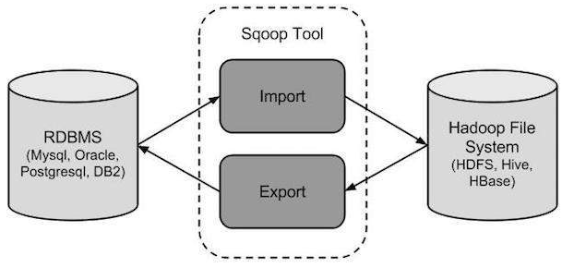
How Sqoop works?

Slide 16
Who uses Sqoop
Online Marketer Coupons.com uses Sqoop to exchange data between Hadoop and IBM Netezza data warehouse
They are querying the structure data and pipes the results to Hadoop
Education company The Apollo group also uses the software to inject the results from Hadoop jobs back to relational databases

Slide 17
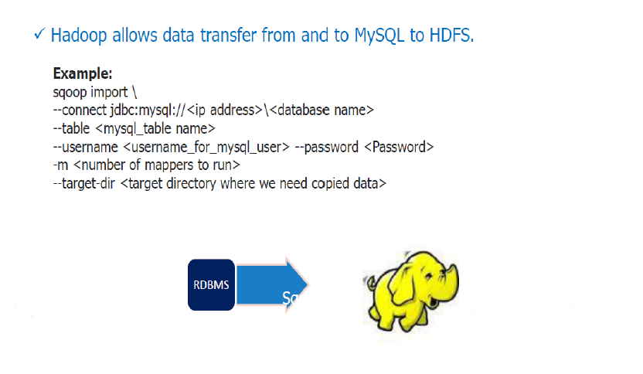
MySQL to HDFS

Slide 18
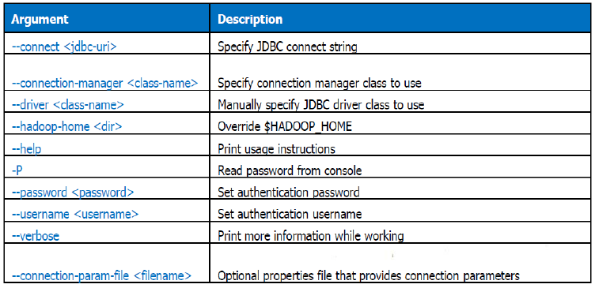
MySQL to HDFS

Slide 19
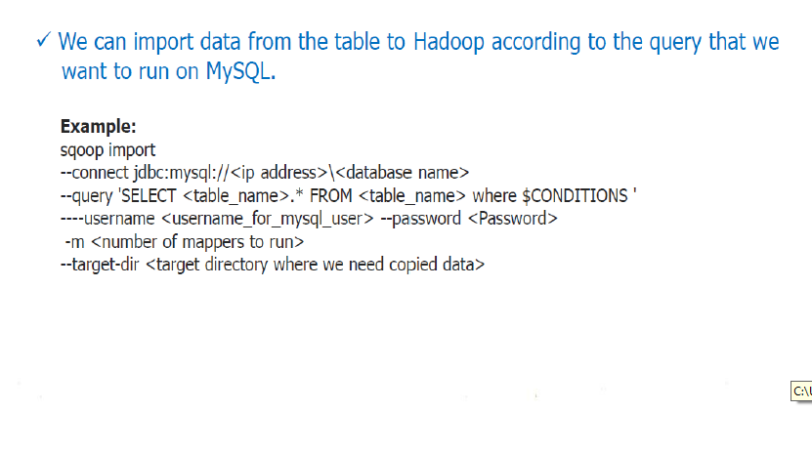
Selective Imports

Slide 20
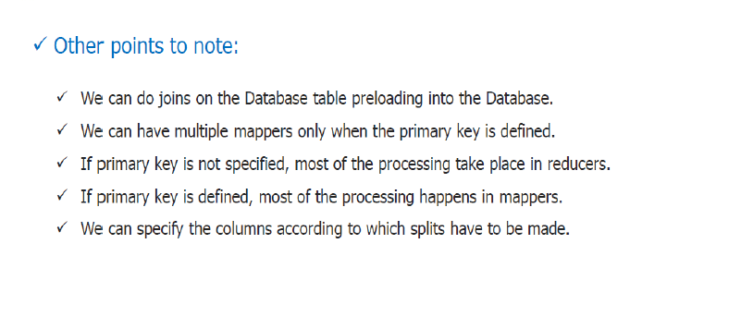
Selective Imports

Slide 21
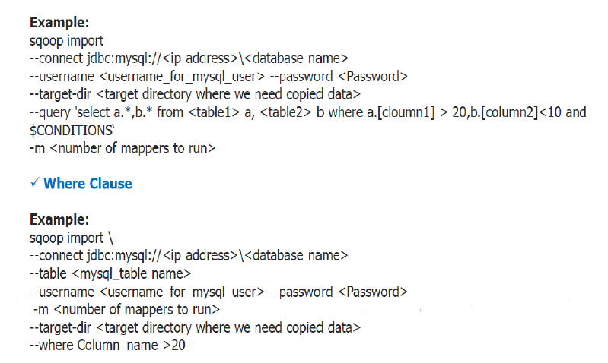
Joining Table

Slide 22
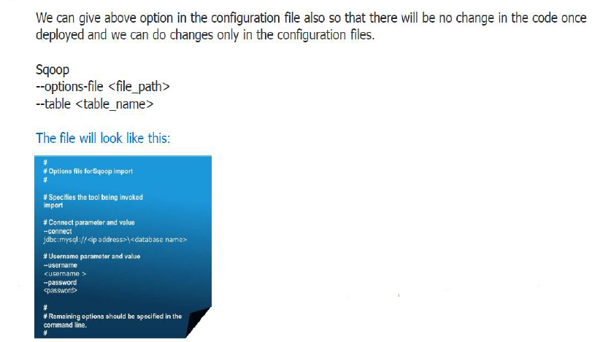
Option File

Slide 23
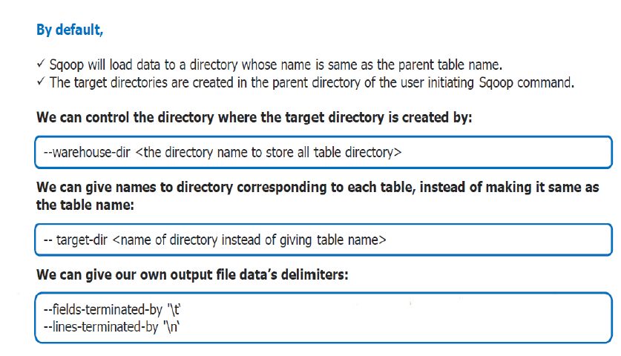
Controlling Import Process

Slide 24
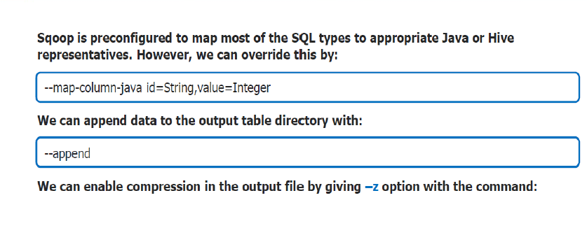
Controlling Import Process

Slide 25
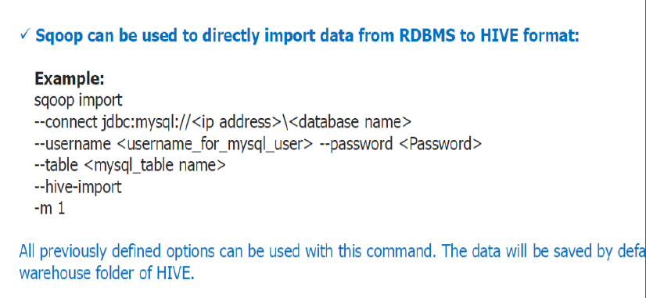
Import to Hive

Slide 26
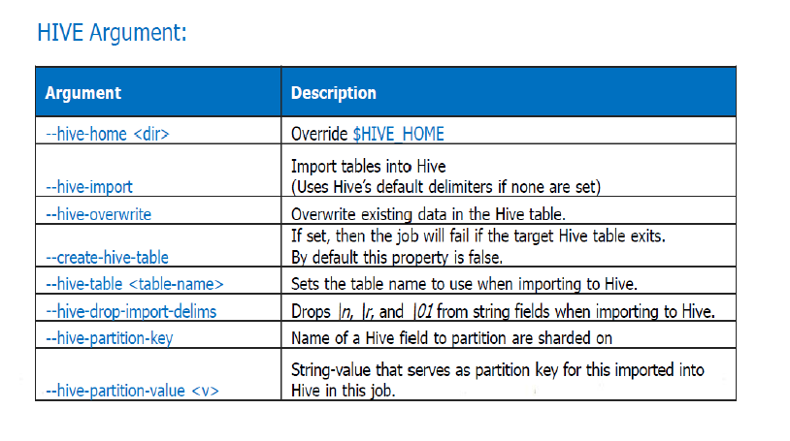
Import to Hive

Slide 27
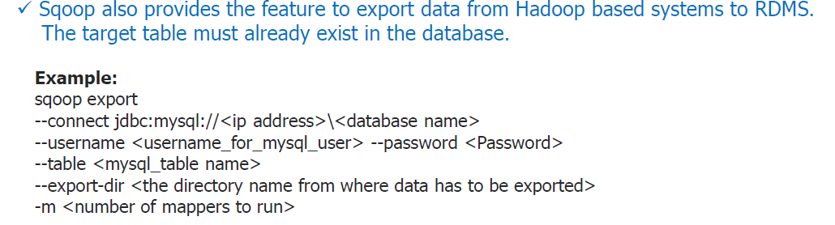
Export from HDFS to Mysql

Slide 28
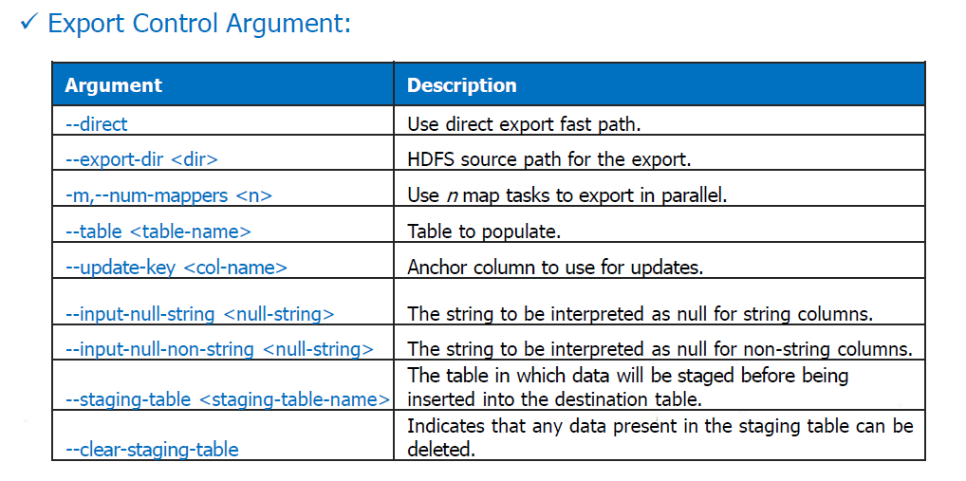
Export from HDFS to MySql

Slide 29
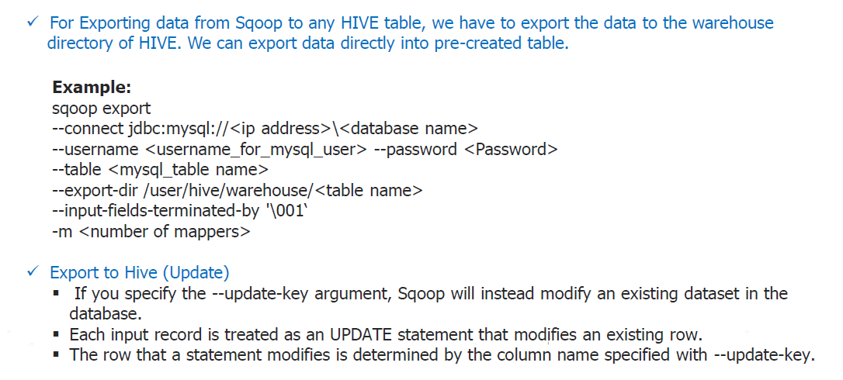
Export to Hive

Slide 30
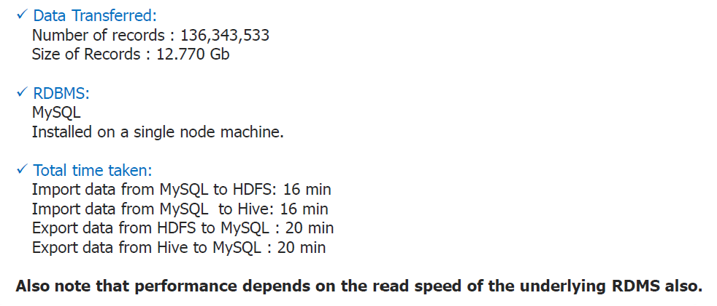
Performance

Slide 31
In Class Exercise
Part - 1

Slide 32
Part 1
Create table in MySQL and Import into HDFS through Sqoop
Export table from HDFS to MySQL

Slide 33
MySQL
Step:1
Start the MySQL service with the below command: sudo service mysqld start
And enter MySQL shell using the below command: mysql -u root -pcloudera

Slide 34
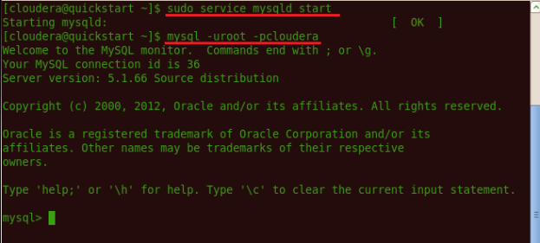
MySQL

Slide 35
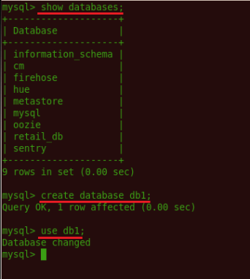
MySQL
Step:2 Command to list database if already existing: show databases; Command to create a new database: create database db1; Command for using the database: use db1;

Slide 36
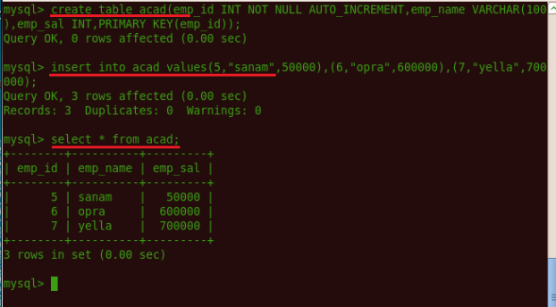
Step:3 Also creating table, inserting values inside table is done using the following syntax. create table <table name>(column name1, column name 2);
insert into <table name> values(column1 value1, column2 value1);

Slide 37
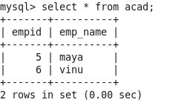
The import tool imports individual tables from RDBMS to HDFS. Each row in a table is treated as a record in HDFS
Sql table

Slide 38
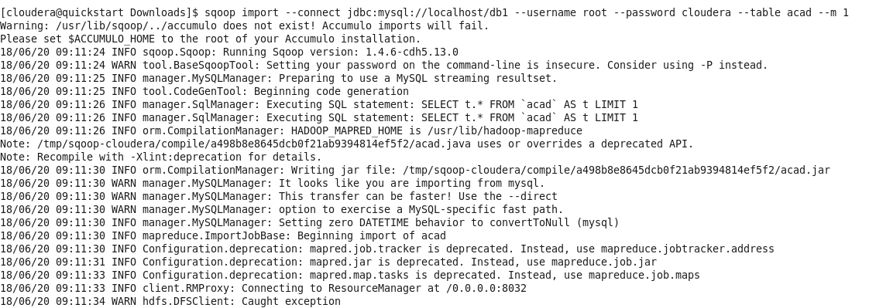
Sqoop - import
Importing a Table
sqoop import --connect jdbc:mysql://localhost/db1 --username root --password cloudera --table acad --m 1
MAC Note: sqoop import –direct --connect “jdbc:mysql://localhost/db1?useSSL=false” --username root --password cloudera --table acad --m 1

Slide 39
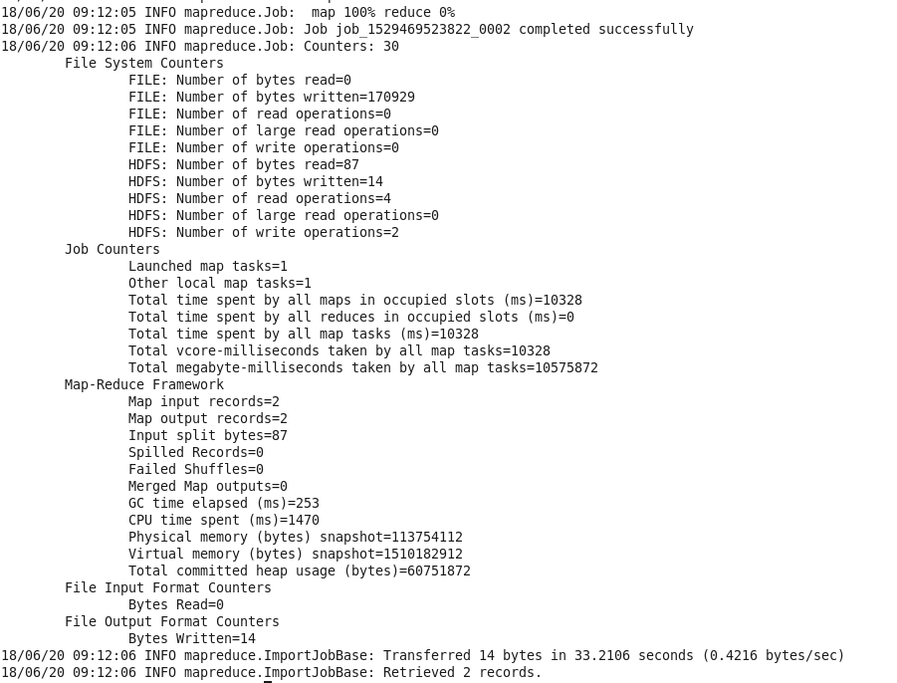
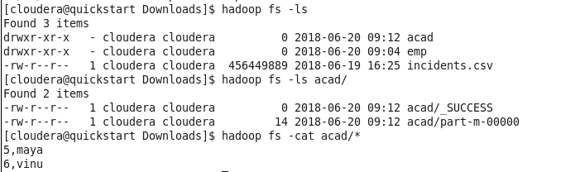
Sqoop - import
hadoop fs -ls
hadoop fs –ls acad/
hadoop fs -cat acad/*

Slide 40
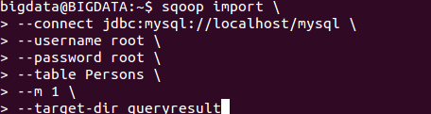

Cont..
Importing into Target Directory
verify the imported data in /queryresult directory form Persons table.

Slide 41
Cont..
Import All Tables
Each table data is stored in a separate directory and the directory name is same as the table name
Syntax

Slide 42
Sqoop - Export
The export tool exports a set of files from HDFS back to an RDBMS. The files given as input to Sqoop contain records, which are called rows in table.
Syntax
It is mandatory that the table to be exported is created manually and is present in the database from where it has to be exported.

Slide 43
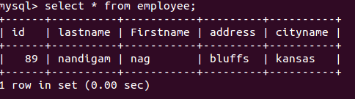
Cont..
Command is used to export the table data from hadoop to Sql

Slide 44
In Class Exercise
Part - 2

Slide 45
Create Hive Tables Using HQL
https://umkc.box.com/s/49lcsiw6waliuwyfzpx0kcmvxln9crj1
Table and Schema Creation through HQL Script
hive –f tables-schema.hql
Note:
Download the data (data/employees from SourceCode Link)
Change the location of data in file based on your data.
Comment lines (--) with DB in HQL File (3 lines)

Slide 46
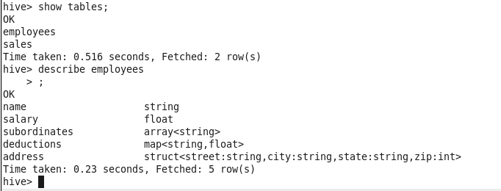
Create Hive Tables Using HQL

Slide 47
Target SQL Construction
Can Complex Datatypes to represented in SQL ?
Hive Complex Data Types: https://acadgild.com/blog/hive-complex-data-types-with-examples

Slide 48
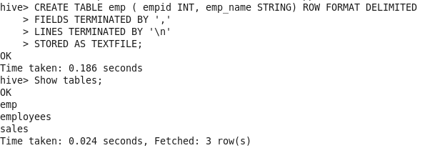
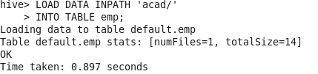

Easier Hive Table to mySQL

Slide 49
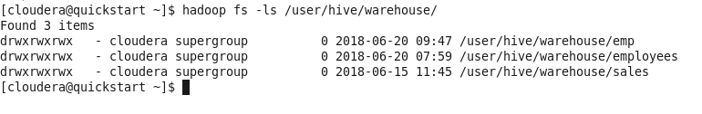

Easier Hive Table to mySQL
Location of hive tables: (our existing emp is our interest)
Creating mysql target Table empNew

Slide 50
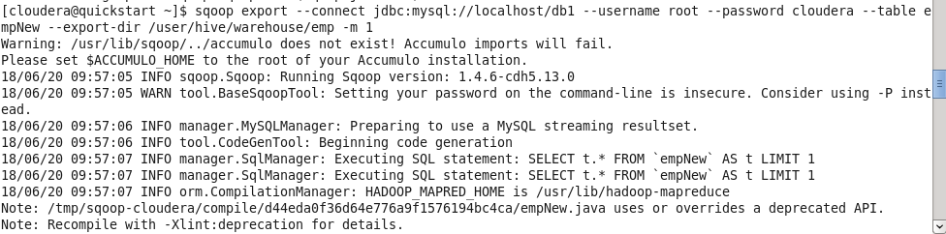
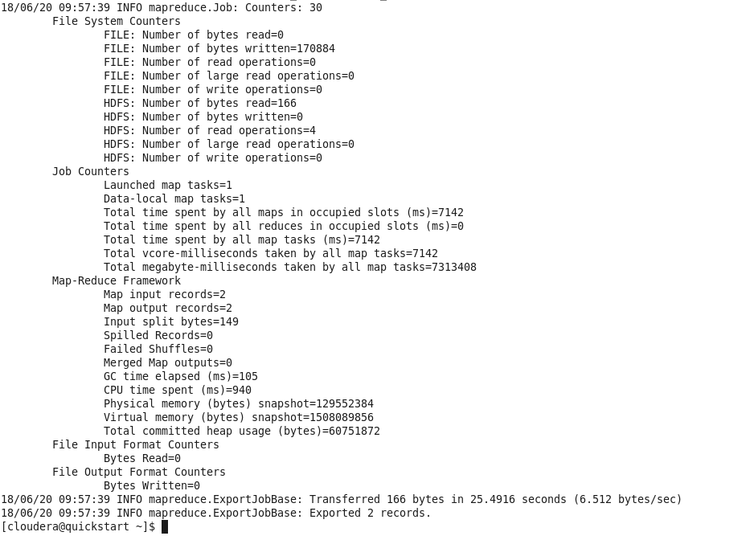
Exporting Table to MySQL empNew through sqoop
sqoop export --connect jdbc:mysql://localhost/db1 --username root --password cloudera --table empNew --export-dir /user/hive/warehouse/emp -m 1

Slide 51
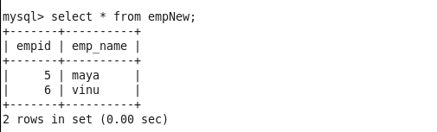
Target mySQL Table
The Data from Hive Table has been transferred to the MySQL Table

Slide 52
In Class Exercise
Part - 3

Slide 53
Choose one of following datasets
Dividends
Employees
Shakespeare
Stocks
Twitter
https://umkc.box.com/s/8is0c8art4f11niveubv7ydjayzg9xzn

Slide 54
Choose one of the tasks
Create Hive Table and export to MySQL
Create SQL Table and import as Hive

Slide 55
Form 3 intuitive questions from your data
Statistics
WordCount
Identifying pattern
Convert these questions to queries

Slide 56
References
http://sqoop.apache.org/
https://www.tutorialspoint.com/sqoop/index.htm
https://hortonworks.com/apache/sqoop/#section_1

